Slide 1
INSAID TELECOM ANALYSIS
Analysis by: GROUP -1001

Slide 2

TABLE OF CONTENT
Introduction
Data Science Tools
Project Description
Problem Statement
Source of Data
Summary of Data Mining
Proposed Solutions
Observation
Conclusion

Slide 3

INTRODUCTION
InsaidTelecom, one of the leading telecom players, understands that customizing offering is very important for its business to stay competitive.
Currently, Insaid Telecom is seeking to leverage behavioral data from more than 60% of the 50 million mobile devices active daily in India to help its clients better understand and interact with their audiences.

Slide 4









DATA SCIENCE TOOLS

Slide 5
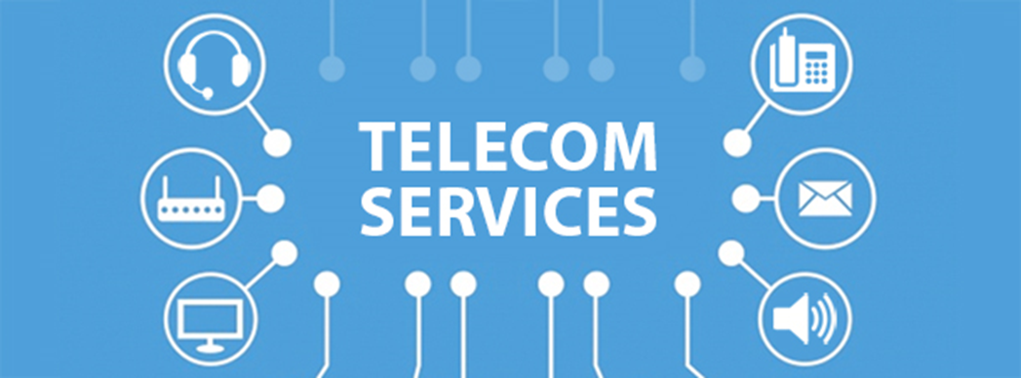
PROJECT DESCRIPTION
In this consulting assignment, Insaidians are expected to build a dashboard to understand user's demographic characteristics based on their mobile usage, geolocation, and mobile device properties.
Doing so will help millions of developers and brand advertisers around the world pursue data-driven marketing efforts which are relevant to their users and catered to their preferences.

Slide 6

PROBLEM STATEMENT
Currently, there is no proper tool to check on the behavior of the user on the phone brand they use, in which city it was used etc.
The team mainly focussed on Delhi in their Analysis.
Since there is no proper consultation done and it is required to do by understanding the user behavior on the below parameters:
a) Demographic profile like Age, Gender.
b) Regional profile like State, City.
c) Different Brand usage
This will help the company to understand what is the right way forward and suggest actionable insights from marketing and product terms.

Slide 7
SOURCE OF DATA
Event Dataset
3,252,950 records, 7 field - event_id, device_id, timestamp, latitude, longitude, city, state.
when a user uses mobile on INSAID Telecom network, the event gets logged in this data.
Gender-Age Dataset
74,645 records, 4 fields - Devices and their respective user gender, age and age_group
Phone Barand Device Model Dataset
87,726 records, 3 fields - Device ids, brand, and models phone_brand: note that few brands are in Chinese

Slide 8
SUMMARY OF DATA MINING
Events_Data -
Observation | Solution
For some of the records found as negative value in all three dataset. | Converted device_id to positive values using abs()
It is observed that device_id is in scientific numbers | Converted Scientific numbers to normal int/object
There are 453 Missing values in device_id. | Located the Location of missing device_id w.r.t city and plotted the same on map using folium.
DataType of a variable 'timestamp' is object in the event dataset. | Values converted into datetime using to_datetime
There are 423 Missing values in latitude and longitude | 1. Latitude and Longitude data points plotted on map using folium. 2. #63 locations were anomaly, these observations were removed from events data.

Slide 9
SUMMARY OF DATA MINING
Gender_Age_Train -
Observation | Solution
Minimum age of the user is 1 year and maximum is 96 years in age_gender dataset. | We can check the outlier by plotting a box plot and calculating IQR for the feature.
We can conclude that there is a outlier present in the dataset. There are 3160 records found as an outlier.
There is no significance change in the mean and median after removing the outlier.
Average Age for User is 31 Years and Median Age of Users is 29.
Density of users are high between 21 Years - 40 Years
It can be observed that 64% of the device registered are MALE and 36% are FEMALE

Slide 10
SUMMARY OF DATA MINING
Phone_Brand_Device_Model -
Observation | Solution
60 Unique device_model
Some device model has names in foreign language. | 1. Foreign Language can be converted to English using Google Translate and a python list can be made. 2. These list can be used to replace the names.
Users with 'Xiaomi','Samsung' and Huawei are high.
235 Unique device model.
Some device model has names in foreign language. | 1. Foreign Language can be converted to English using Google Translate and a python list can be made. 2. These list can be used to replace the names.

Slide 11
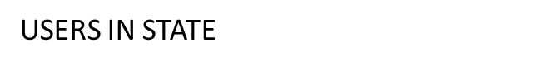
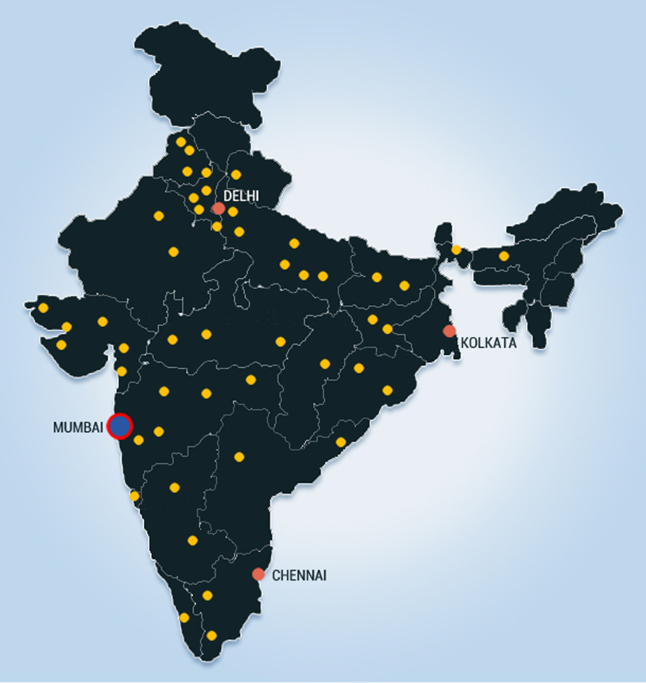
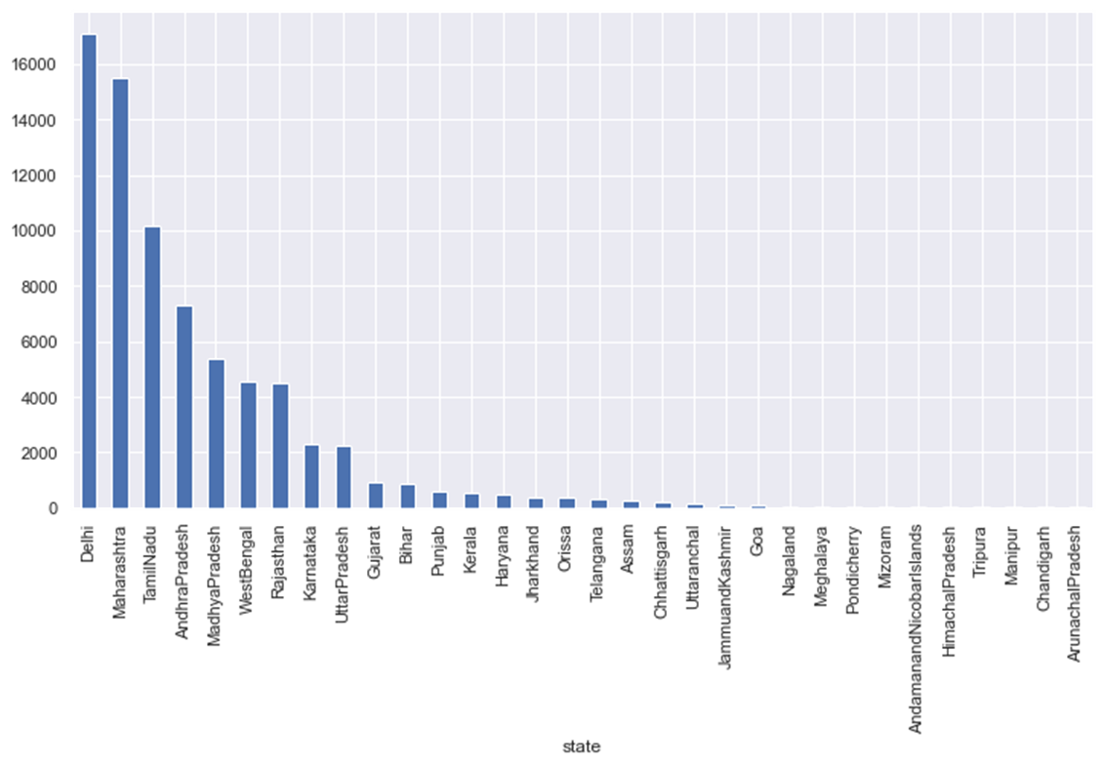
PROPOSED SOLUTION
Delhi, Maharashtra and Tamilnadu has highest potential in Business as maximum users are from these states. Delhi is the most focused state for the Business development.

Slide 12
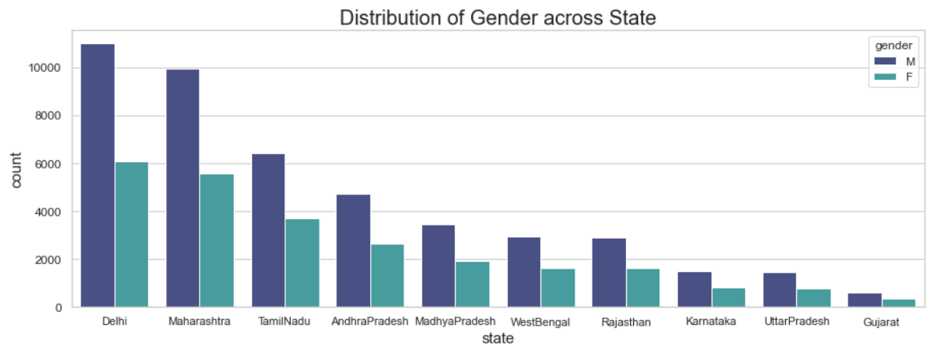
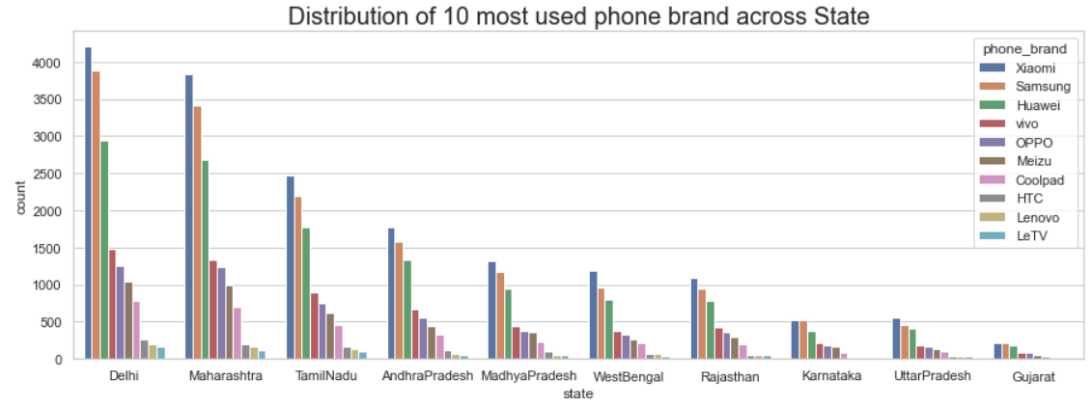
PROPOSED SOLUTION
Delhi has the maximum Male and Female users as compared to other states.
Delhi has the highest potential users for all the brands. It generate high volume of business. INSAID telecom can also focus on the states like Maharashtra and TamilNadu for the business growth.

Slide 13
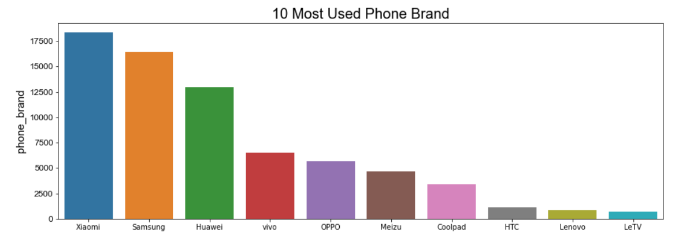
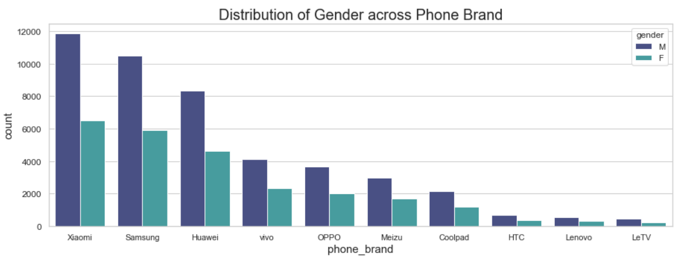
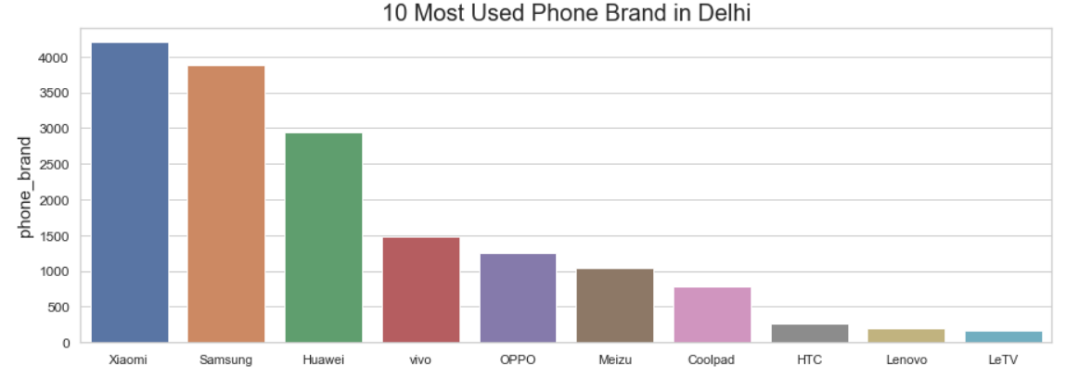
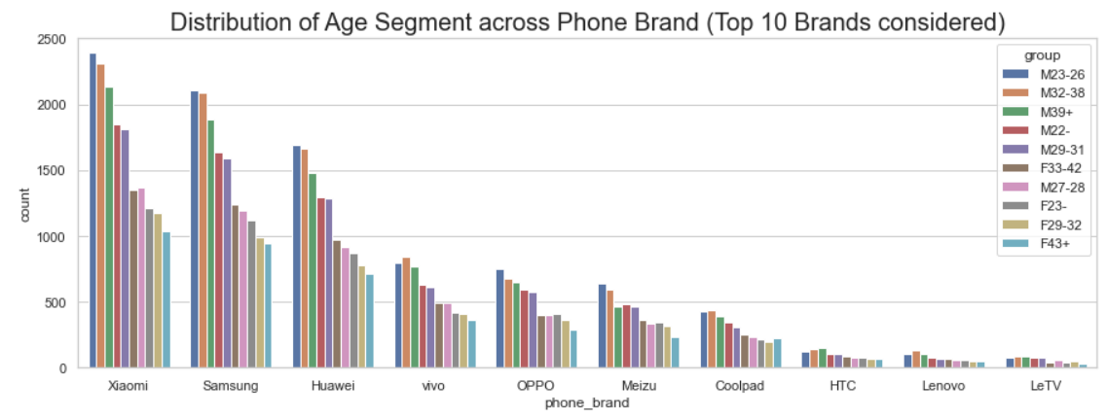
PROPOSED SOLUTION
Xiaomi is the most trusted brand across all Markets including Delhi as its usage is high among all other brands. INSAID telecom can focus on this Brand along with Samsung and Huawei as they are the potential Brands for Business growth. Top 10 phone brands for Delhi are same as overall States top 10 Brands.
Redmi Note is the most used Device model across all model. They can target these device model for their Business expansion.

Slide 14
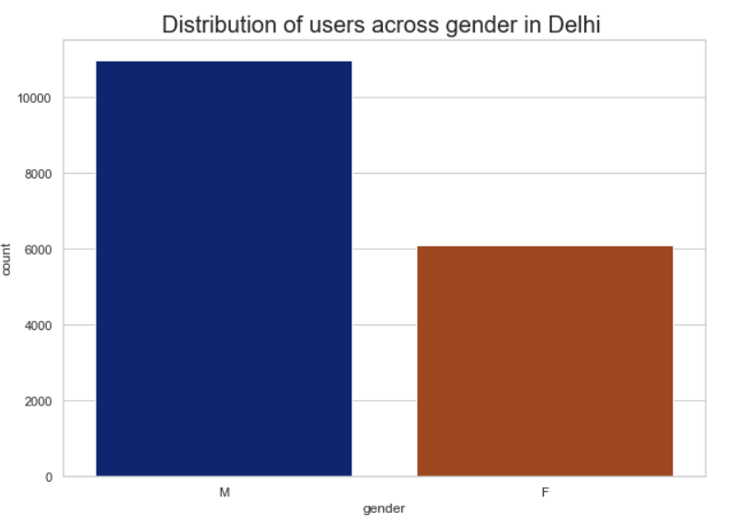
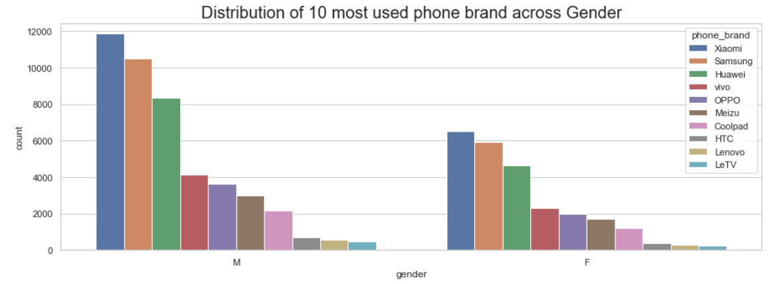
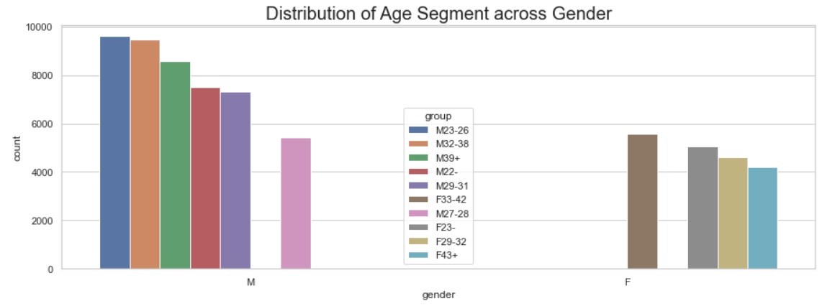
PROPOSED SOLUTION
Male user are high potential user as they are around 64% as compared to Female user which are just 36%.
Usage of phone brand across gender are same.
Male user between age 23-26 are the potential users whereas in Female age between 33-42 are the potential users.

Slide 15
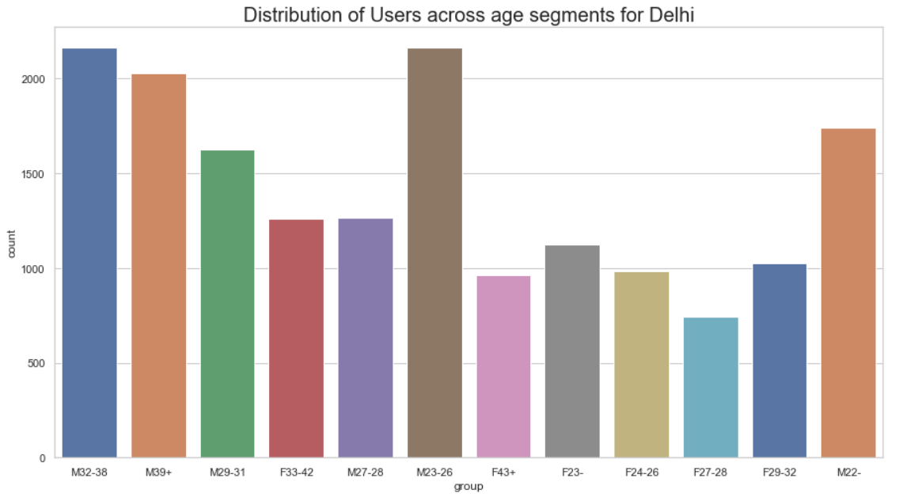
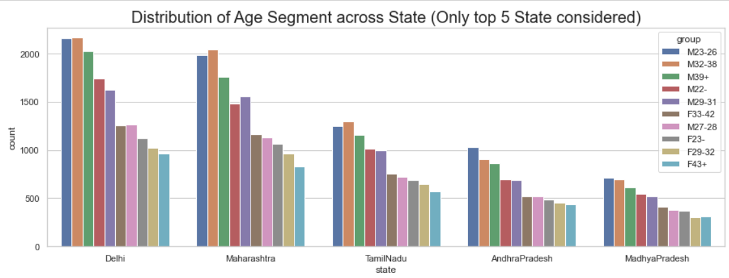
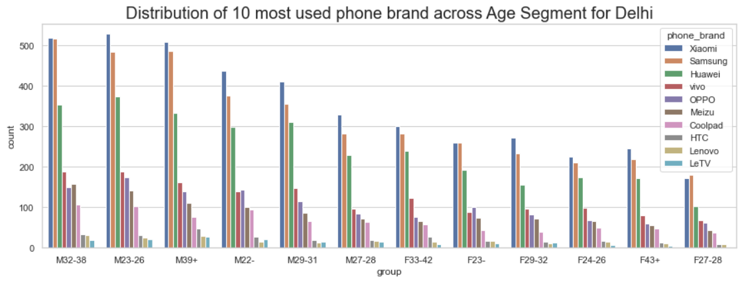
PROPOSED SOLUTION
In top states like Delhi, Maharashtra and TamilNadu Male age group 32-36 are high potential users where as in other states Male age group 23-26 are high potential users.
In popularity, Xiaomi is the most popular brand across all age group. INSAID telecom can focus on this brand for their Business expansion.

Slide 16
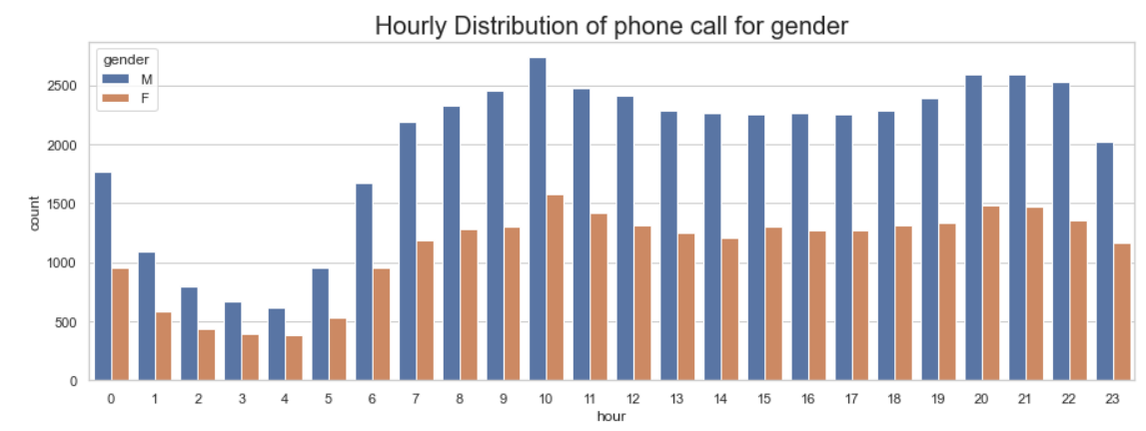
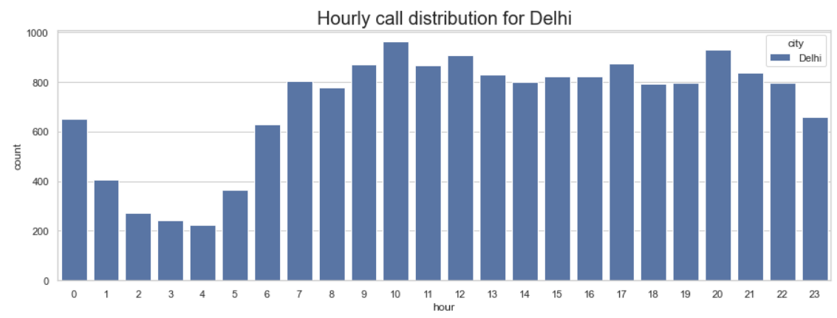
PROPOSED SOLUTION
Service All Users by Hour
Across gender, it is clearly shown that the users are more active at 10am.
Delhi users are more active at 10am and 8pm as this is the start and end of their peak working time.
Service Delhi Users by Hour

Slide 17
OBSERVATION
From the given dataset the below Observation can be drawn:
1. Delhi has the maximum number of users with the count of 17078 followed by Maharashtra with 15509 and TamilNadu with 10137.
2. The top 10 most used brands are Xiaomi with 18357 users, Samsung with 16424, Huawei with 12990, vivo with 6475, OPPO with 5650, Meizu with 4686, Coolpad with 3359, HTC with 1089, Lenovo with 849, LeTV with 698 users.
3. Xiaomi is the most used phone brands across users.
4. Male users are more as compared to female in the data set. Male user are accounted 64% whereas 36% users are female.
5. The users whose age segment falls under 23-26, 32-38 are maximum. The usage of phone is more for the users age between 23 - 38.
6. Usage of phone brand for Male users with Age segment 23-26 are more against other age segments.
7. Usage of phone brand are Higher in Delhi followed by Maharashtra and TamilNadu.
8. Usage of phone brand are higher in Male users as compared to female users.
9. Male users are more than Female in across all the states.
10. Male users with Age group 23-26 and 32-38 records for the maximum counts. In Female Age group 33-42 records the maximum counts.
11. Xiaomi is the most favourite brand across gender followed by Samsung and Huawei.
12. In Delhi the Male users are with Age group 23-26 are more whereas in Maharashtra Male user with Age group 32-38 are more.
13. Male users with Age group 23-26 records for the maximum counts. In Female Age group 33-42 records the maximum counts.
14. Xiaomi is the most favourite brand for age group of Male 23-32. Vivo is the most favourite brand of Male age group 32-38. HTC is most used by the Male user with age is 39+.
15. We observed that at 10 am users are more active making a phone calls. Also, we observed at 20th, 21st and 22nd hours users are active making a calls.Male users are making more calls.
17. The users are more active in Delhi followed by Maharashtra and TamilNadu.

Slide 18
CONCLUSION
INSAID Telecom needs to perform several activities to become a Market leader.
Introduced different plans for different states across different age group.
Provide some discounts to scale more productivity during non productive hours.
Must be special plans for the states where the usage are low.
To increase the usage in Delhi, provide them some privilege offers as Delhi is the most potential market for Business growth.
Tie up with the top Phone brands of the markets based on their usage for more productivity.
Special plans must be there for age group between 23-38 as they are the highest usage consumers.
Provide some kind of discount vouchers to Female users to scale their phone usage as it has the huge potential to scale the Business.
A Detailed Analysis is available in the Jupyter Notebook

Slide 19

THANK YOU

